Slide 1
Tangible 2-Factor Authentication (T2FA)
Mark Turner
Supervised by Karola Marky

Slide 2
Welcome
Passwords most widely used method for authenticating [4], however have many security failings [5]

Slide 3
Welcome
Passwords most widely used method for authenticating [4], however have many security failings [5]
2-Factor authentication improves on this security-wise, but has low adoption rates due to usability problems [6]

Slide 4
Welcome
Passwords most widely used method for authenticating [4], however have many security failings [5]
2-Factor authentication improves on this security-wise, but has low adoption rates due to usability problems [6]
Tangible authentication has been found to be more enjoyable for users, improving usability [7], but tend to rely on batteries or network connection

Slide 5
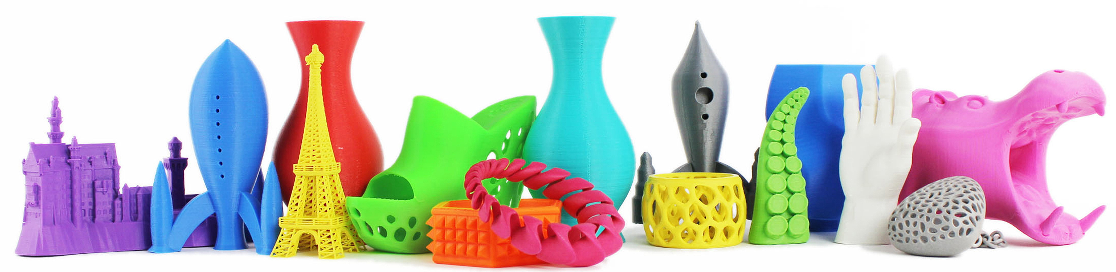
T2FA
[1] Assorted 3D-printed objects
Intended to improve on usability issues of 2FA

Slide 6
T2FA
[1] Assorted 3D-printed objects
Intended to improve on usability issues of 2FA
3D printed objects using conductive and insulating plastic

Slide 7
T2FA
[1] Assorted 3D-printed objects
Intended to improve on usability issues of 2FA
3D printed objects using conductive and insulating plastic
Method of interaction serving as knowledge factor, unique object ‘footprint’ as ownership factor

Slide 8
T2FA
[1] Assorted 3D-printed objects
Intended to improve on usability issues of 2FA
3D printed objects using conductive and insulating plastic
Method of interaction serving as knowledge factor, unique object ‘footprint’ as ownership factor
Don’t rely on batteries – powered by your fingers

Slide 9
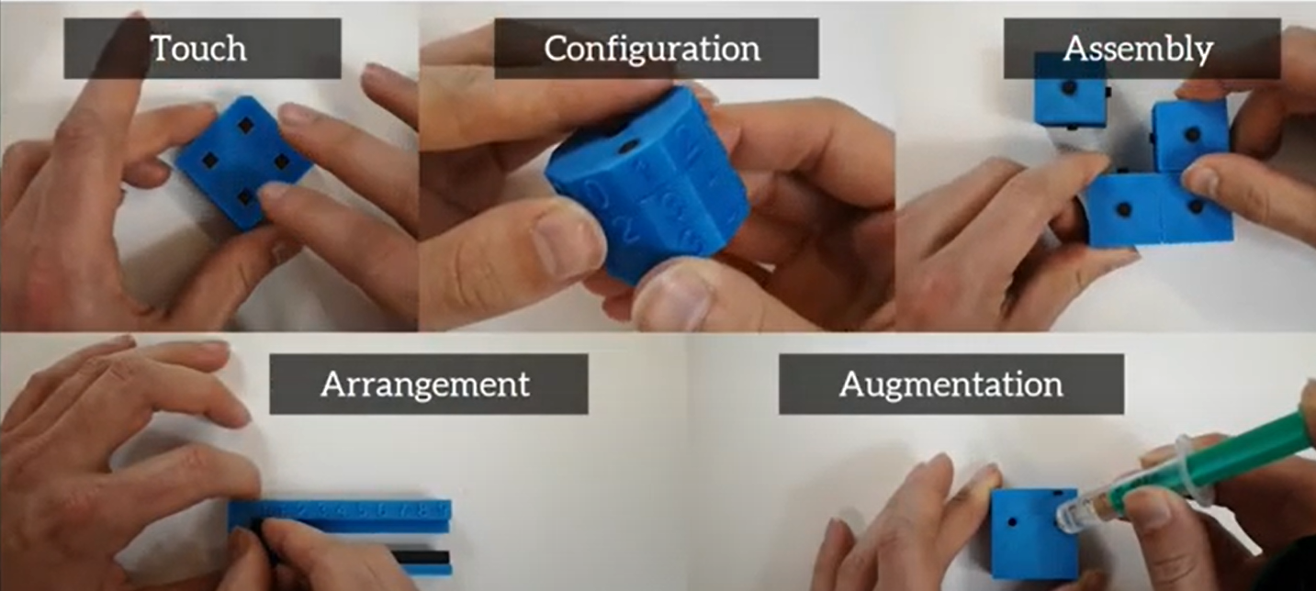
T2FA and 3D-Auth
3D Auth: Two-Factor Authentication with Personalized 3D-Printed Items [3]

Slide 10
T2FA and 3D-Auth
3D Auth: Two-Factor Authentication with Personalized 3D-Printed Items
80% of interactions performed successfully
in the lab study

Slide 11
T2FA and 3D-Auth
3D Auth: Two-Factor Authentication with Personalized 3D-Printed Items
80% of interactions performed successfully
in the lab study
User experience survey indicated neutral
or positive evaluations for each area of
usability

Slide 12
Existing Online Survey
Analysed in order to find desirable traits for authentication objects
of the type investigated
here

Slide 13
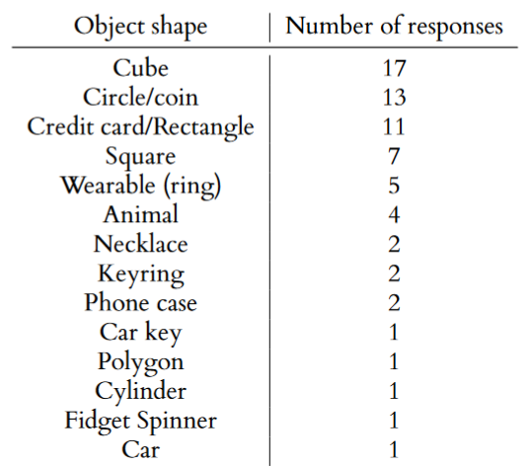
Existing Online Survey
Analysed in order to find desirable traits for authentication objects
of the type investigated
here

Slide 14
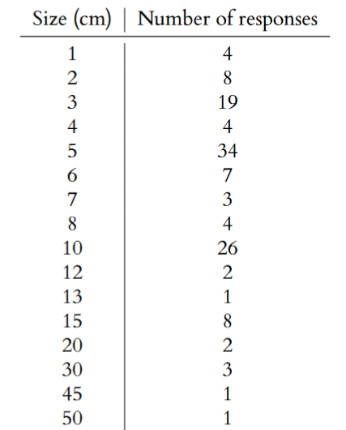
Existing Online Survey
Analysed in order to find desirable traits for authentication objects
of the type investigated
here

Slide 15
New Models
Initial ideas sketched

Slide 16
New Models
Initial ideas sketched
Interactions added

Slide 17
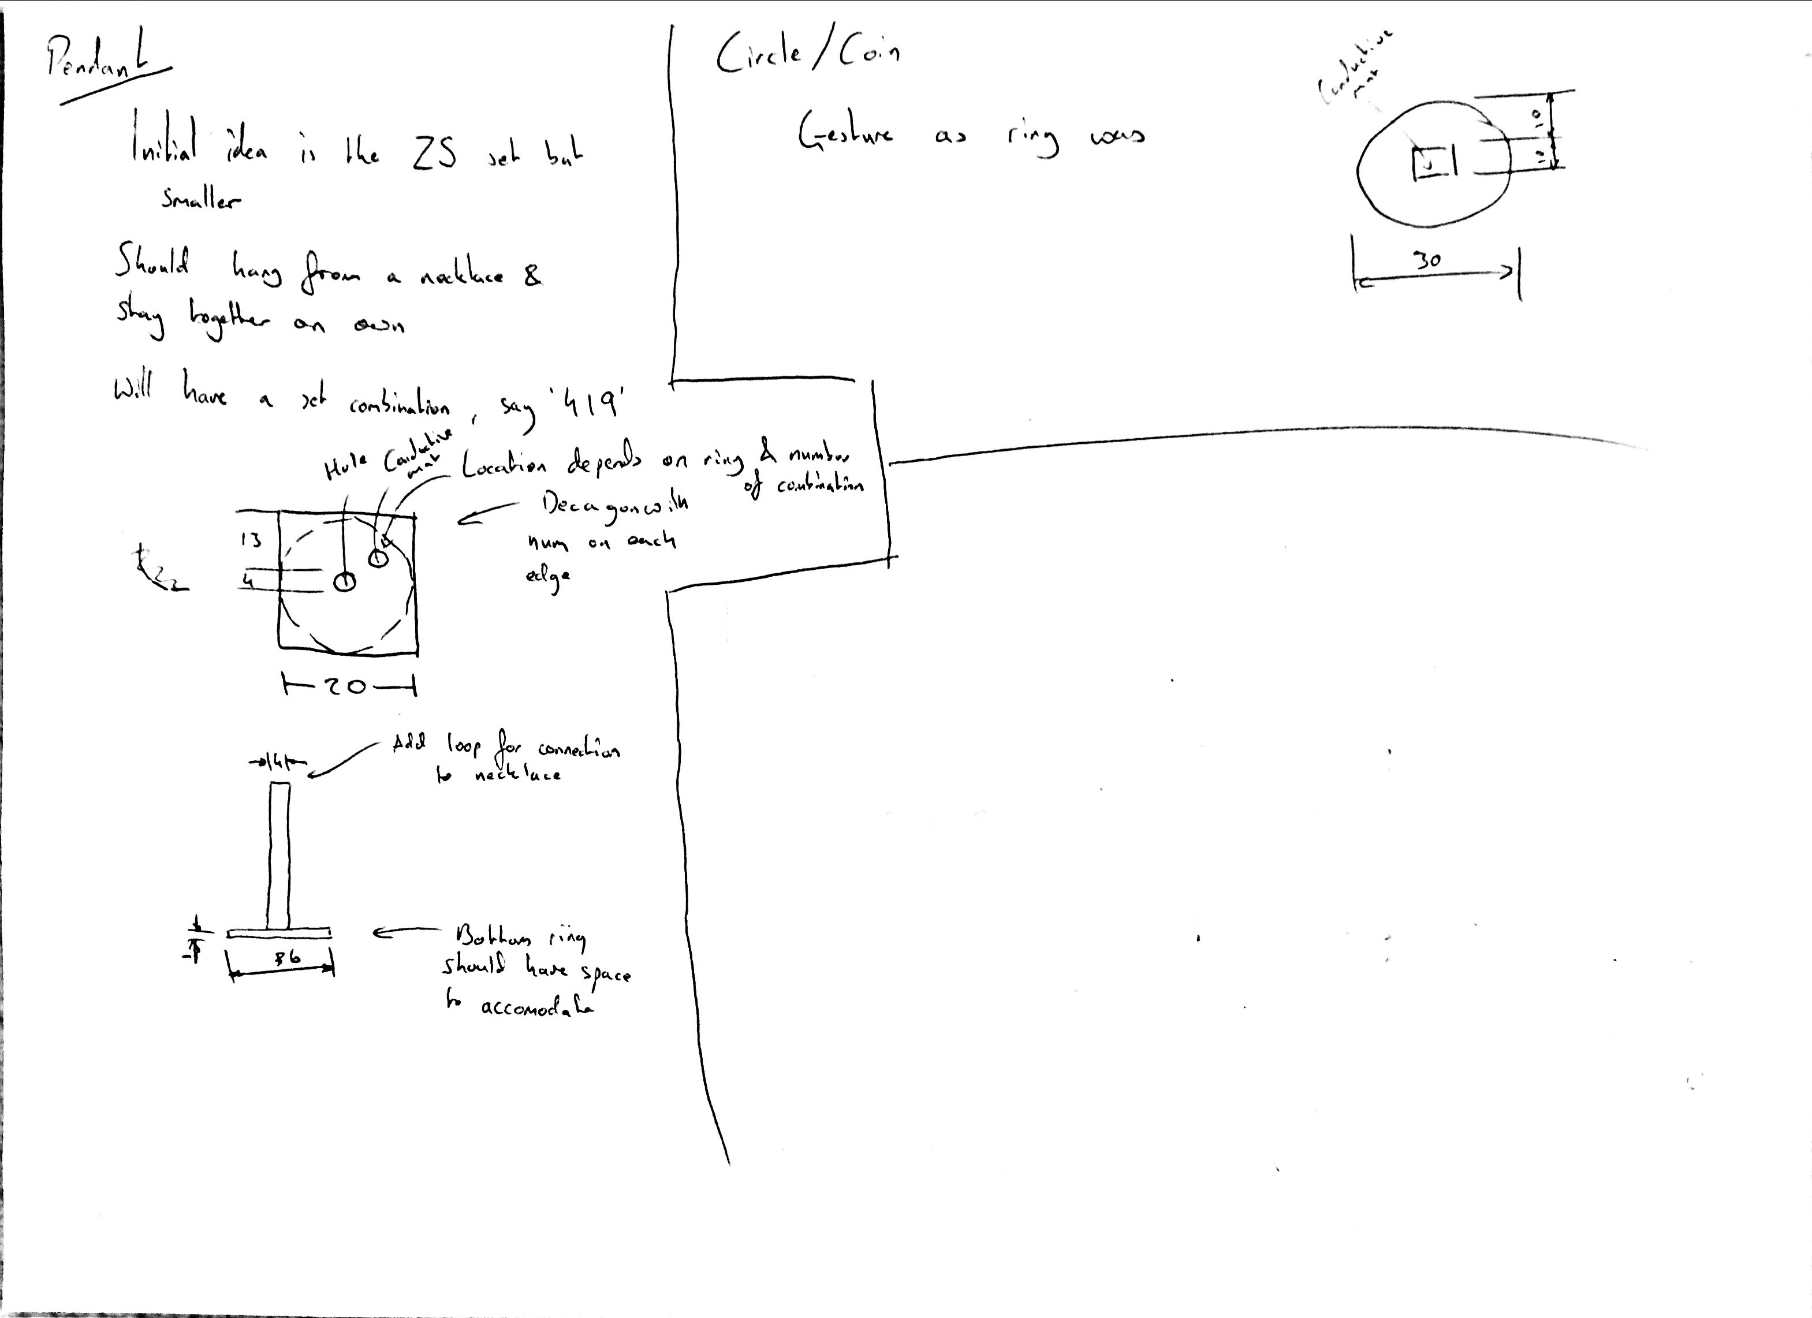
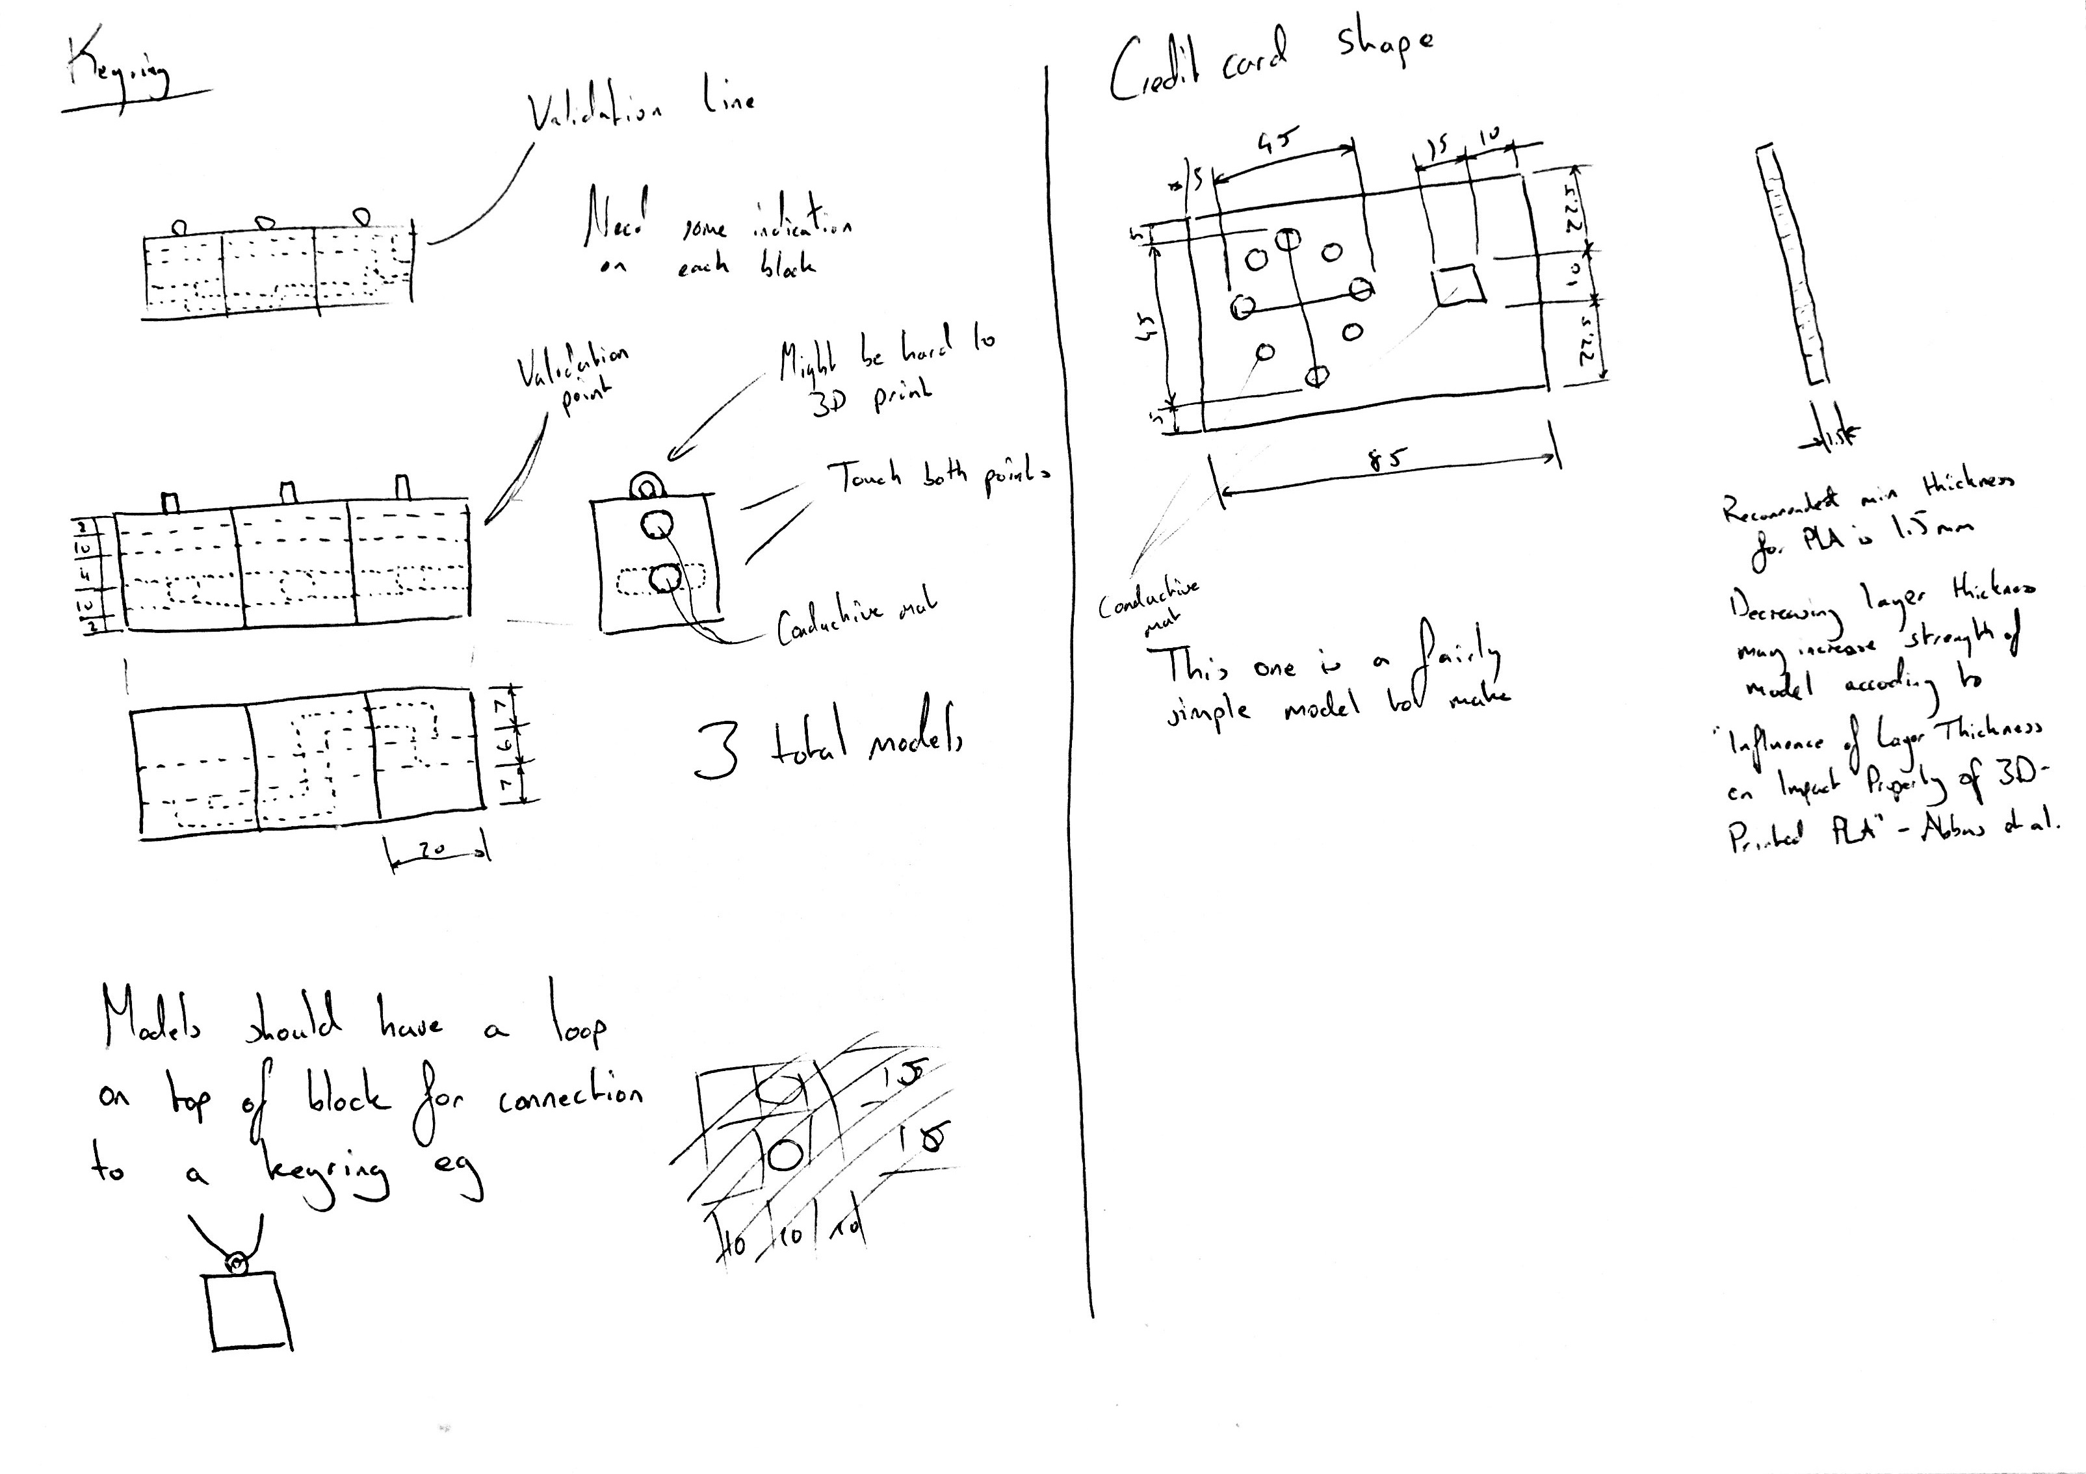
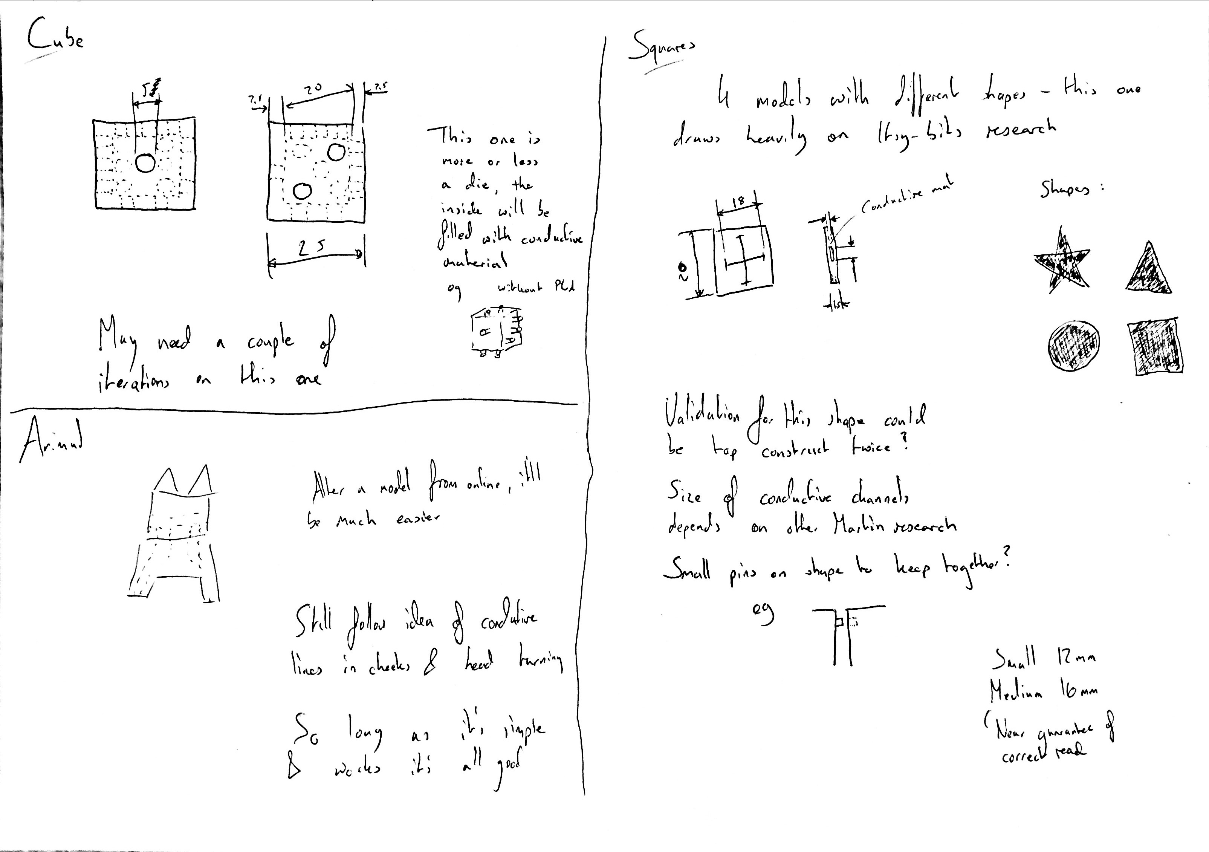
New Models
Initial ideas sketched
Interactions added
Production drawings created

Slide 18
New Models
Initial ideas sketched
Interactions added
Production drawings created
First filter

Slide 19
New Models
Initial ideas sketched
Interactions added
Production drawings created
First filter
Digital models created

Slide 20
New Models
Initial ideas sketched
Interactions added
Production drawings created
First filter
Digital models created
Second filter

Slide 21
New Models
Initial ideas sketched
Interactions added
Production drawings created
First filter
Digital models created
Second filter
Final digital models

Slide 22
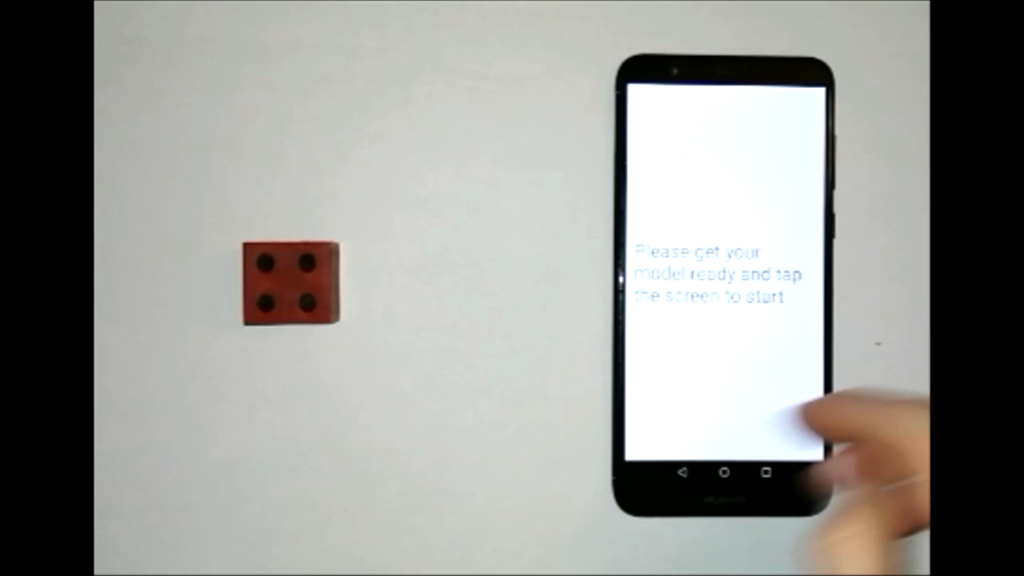
Demonstration

Slide 23
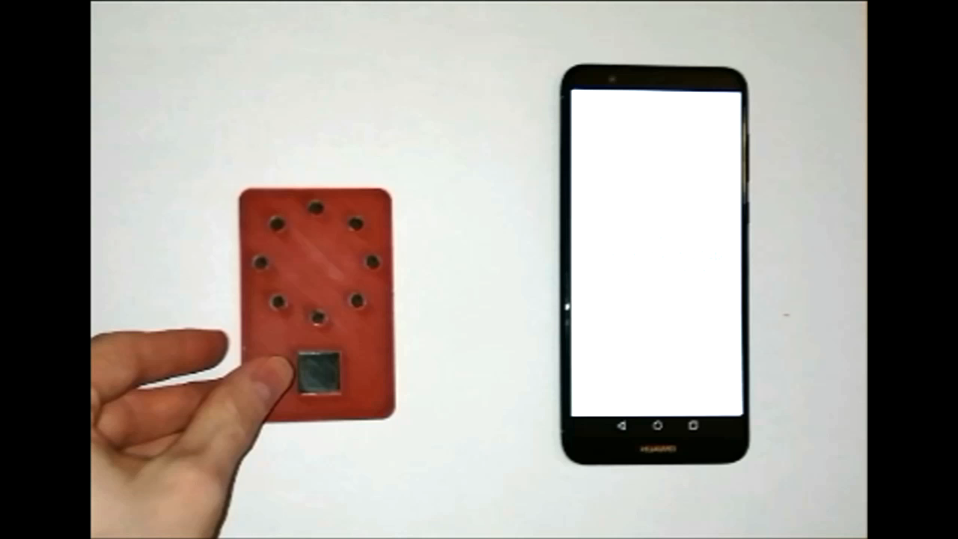
Demonstration

Slide 24
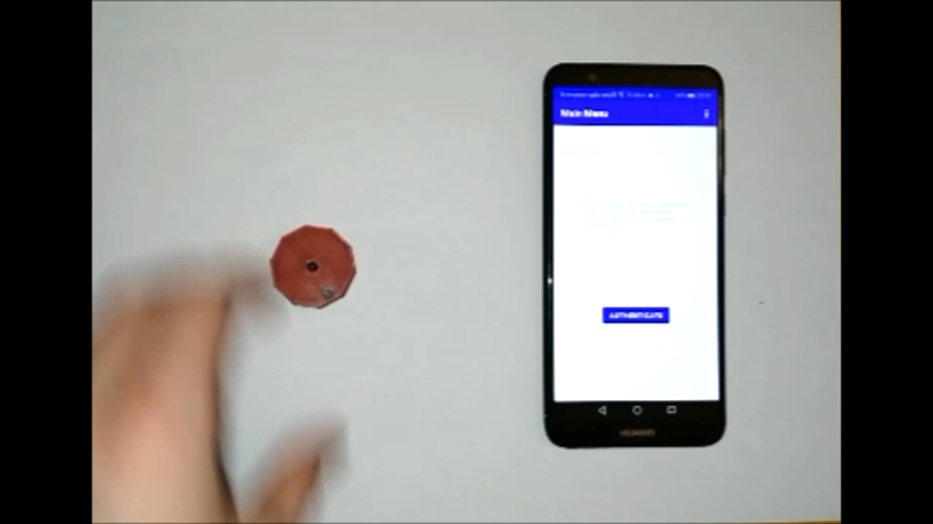
Demonstration

Slide 25

Study app
Notification, data collection and interaction verification
[2] Android logo

Slide 26
Study app
Notification, data collection and interaction verification
MotionEvent.getHistoricalPoints()
MotionEvent.getSize()
[2] Android logo

Slide 27
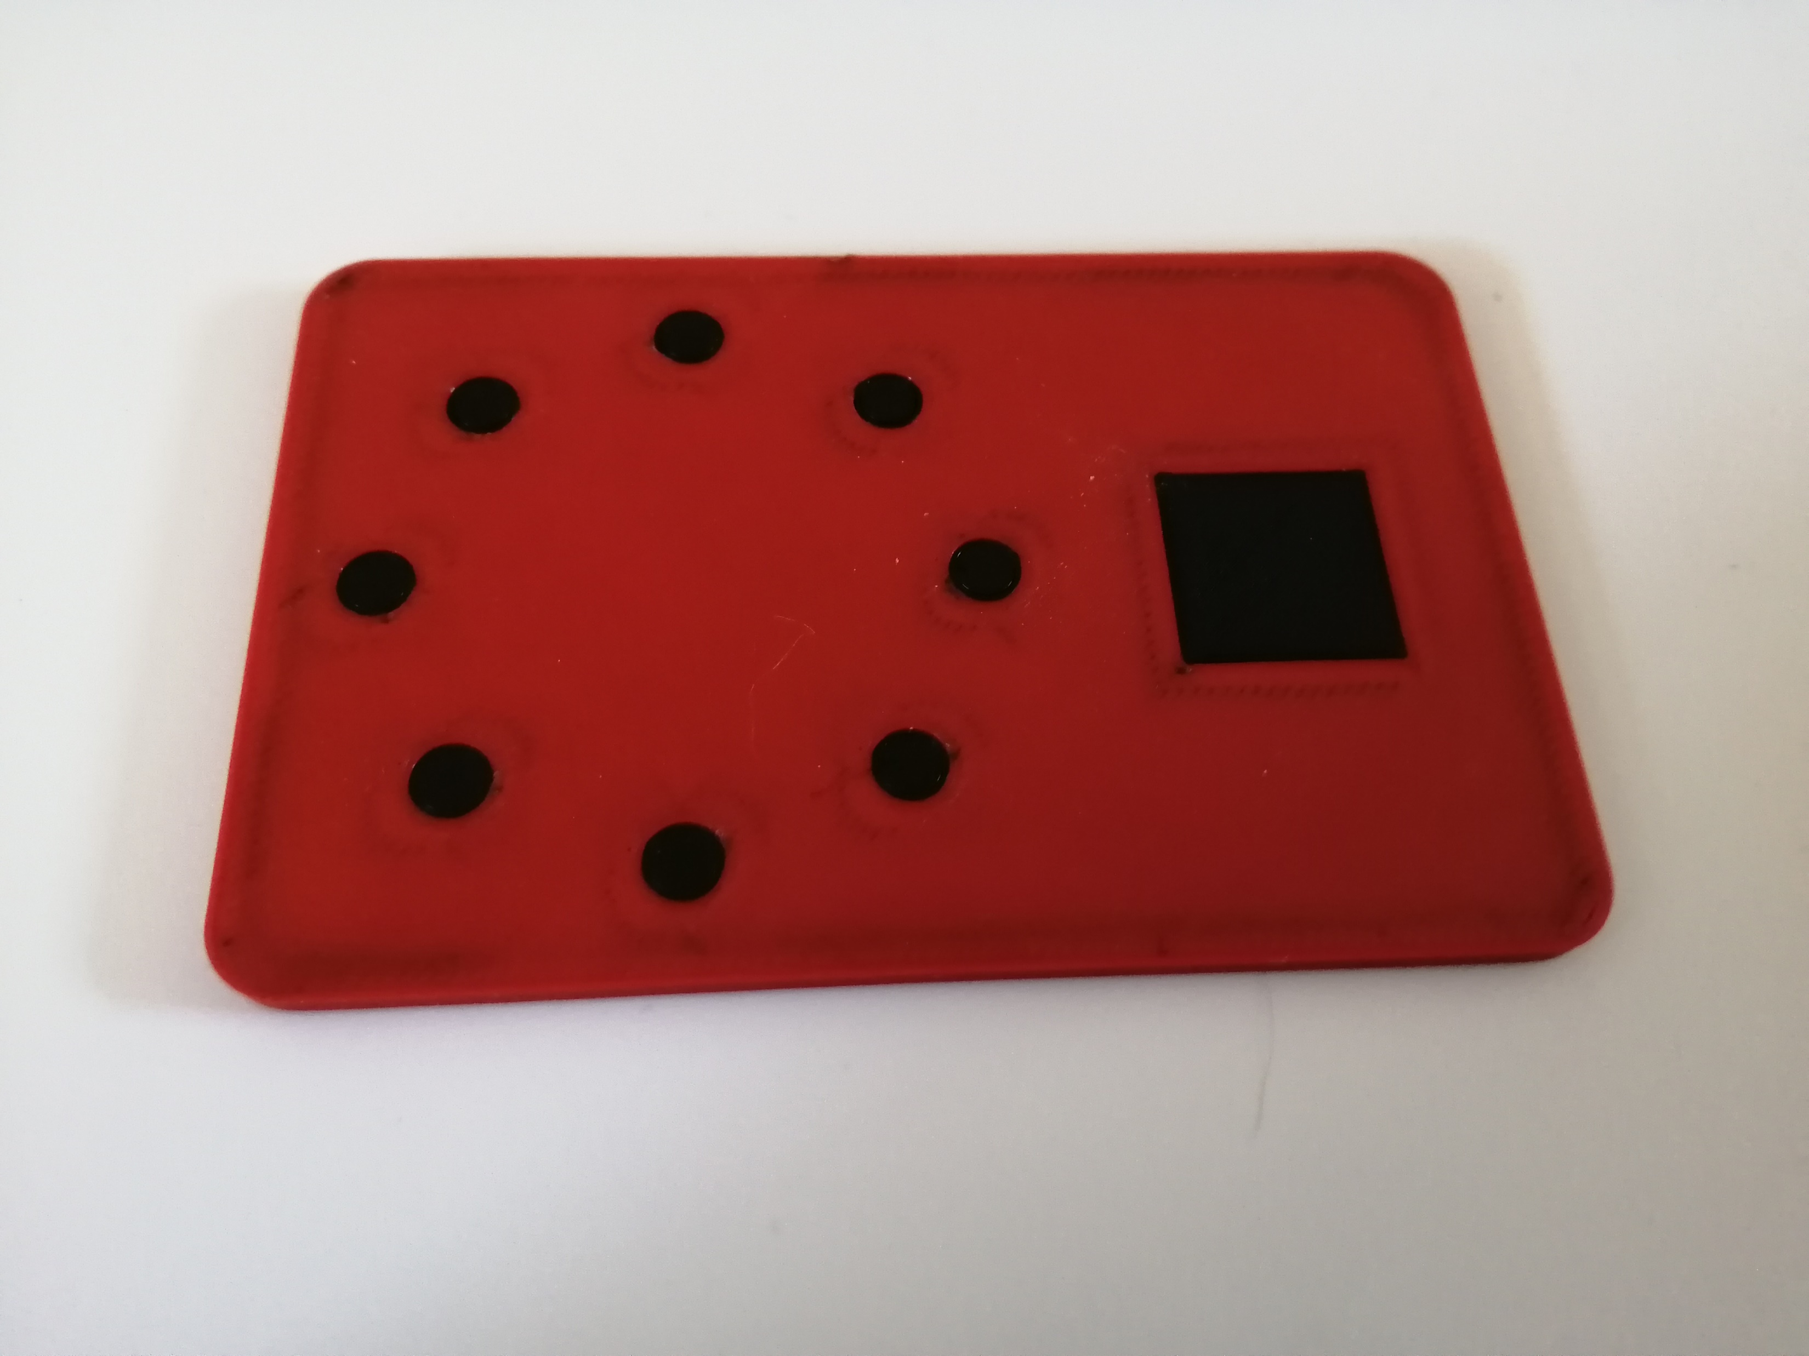
Study
Initial meeting – demographics survey, model assigned and familiarised, contents of study explained

Slide 28
Study
Initial meeting – demographics survey, model assigned and familiarised, contents of study explained
Minimum of 2 mock authentications per day for one week

Slide 29
Study
Initial meeting – demographics survey, model assigned and familiarised, contents of study explained
Minimum of 2 mock authentications per day for one week
Exit meeting – SUS survey, introduction to other models, exit interview and app data collection

Slide 30
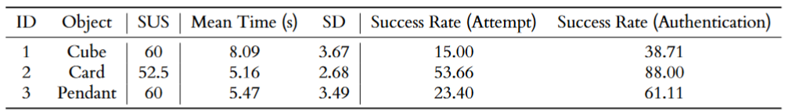
Results

Slide 31
Results
“Sometimes the authentication just wouldn’t go through” (P3)
“I’m not sure if smart phones [are] the best place to use it” (P2)
“It’s a nice and fun […] interaction” (P1)

Slide 32
Limitations
Low number of participants

Slide 33
Limitations
Low number of participants
Faulty study app

Slide 34
Future Research
Perhaps stationary devices over portable devices should be considered

Slide 35
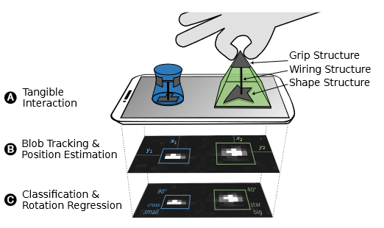
Future Research
Perhaps stationary devices over portable devices should be considered
Utilise raw capacitive data rather than OS functions
M. Schmitz, ItsyBits [8]

Slide 36
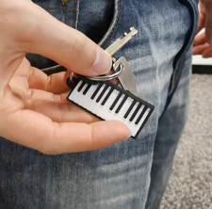
Future Research
Perhaps stationary devices over portable devices should be considered
Utilise raw capacitive data rather than OS functions
M. Schmitz, ItsyBits [8]
Potential for highly customizable and secure objects
[3] Potential future object

Slide 37
Conclusion
Very promising method, with participants eager to use in future

Slide 38
Conclusion
Very promising method, with participants eager to use in future
Issues were unearthed however, and limitations exist in this study, so further research is needed

Slide 39
Thank you
References:
[1] S. Frey. 2017. What Does Resolution Mean for SLA Printers?. Image. Retrieved from: https://theorthocosmos.com/what-does-resolution-mean-for-sla-printers/
[2] Android Logo. 2022. Image. Retrieved from: https://1000logos.net/android-logo/
[3] K. Marky, M. Schmitz, V. Zimmermann, M. Herbers, K. Kunze, and M. Mühlhäuser. 3d-auth: Two-factor authentication with personalized 3d-printed items. In Proceedings of the 2020 CHI Conference on Human Factors in Computing Systems, pages 1–12, 2020.
[4] K. Reese, T. Smith, J. Dutson, J. Armknecht, J. Cameron, and K. Seamons. A usability study of five two-factor authentication methods. In Fifteenth Symposium on Usable Privacy and Security ({SOUPS} 2019), pages 357–370, 2019
[5] E. Stobert and R. Biddle. The password life cycle: User behaviour in managing passwords. In Proceedings of the Tenth USENIX Conference on Usable Privacy and Security, SOUPS ’14, page 243–255, USA, 2014. USENIX Association. ISBN 978193197
[6] S. Das, A. Dingman, and L. J. Camp. Why johnny doesn’t use two factor a two-phase usability study of the fido u2f security key. In International Conference on Financial Cryptography and Data Security, pages 160–179. Springer, 2018
[7] M. Sherman, G. Clark, Y. Yang, S. Sugrim, A. Modig, J. Lindqvist, A. Oulasvirta, and T. Roos. User-generated free-form gestures for authentication: Security and memorability. In Proceedings of the 12th annual international conference on Mobile systems, applications, and services, pages 176–189, 2014.
[8] M. Schmitz, F. Müller, M. Mühlhäuser, J. Riemann, and H. V. V. Le. Itsy-bits: Fabrication and recognition of 3d-printed tangibles with small footprints on capacitive touchscreens. In Proceedings of the 2021 CHI Conference on Human Factors in Computing Systems, pages 1–12, 2021.

